Slide 1
Spark
Unit V

Slide 2
Introduction
Apache Spark is a cluster computing platform designed to be fast and general purpose.
On the speed side, Spark extends the popular MapReduce model to efficiently support more types of computations, including interactive queries and stream processing.
Speed is important in processing large datasets, One of the main features Spark offers for speed is the ability to run computations in memory, but the system is also more efficient than MapReduce for complex applications running on disk.
On the generality side, Spark is designed to cover a wide range of workloads : separate distributed systems, including batch applications, iterative algorithms, interactive queries, and streaming.

Slide 3
By supporting these workloads in the same engine, Spark makes it easy and inexpensive to combine different processing types, which is often necessary in production data analysis pipelines.
In addition, it reduces the management burden of maintaining separate tools.
Spark is designed to be highly accessible, offering simple APIs in Python, Java, Scala, and SQL, and rich built-in libraries.
It also integrates closely with other Big Data tools. Hadoop clusters and access any Hadoop data source, including Cassandra.

Slide 4
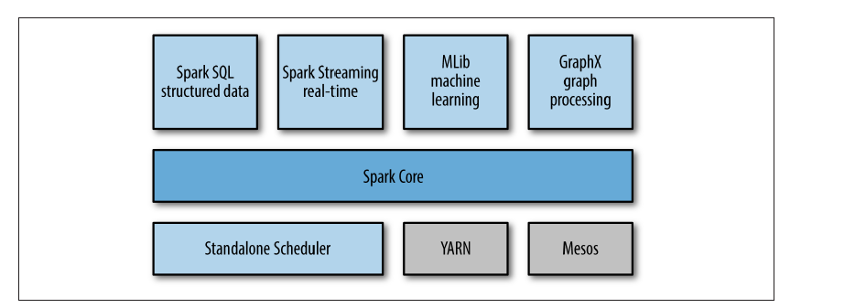
The Spark Stack

Slide 5
Spark
At its core, Spark is a “computational engine” that is responsible for scheduling, distributing, and monitoring applications consisting of many computational tasks across many worker machines, or a computing cluster.
Because the core engine of Spark is both fast and general-purpose, it powers multiple higher-level components specialized for various workloads, such as SQL or machine learning. These components are designed to interoperate closely, letting you combine them like libraries in a software project.

Slide 6
Spark Core
Spark Core contains the basic functionality of Spark, including
components for task scheduling,
memory management,
fault recovery,
interacting with storage systems, and more.
Spark Core is also home to the API that defines resilient distributed datasets (RDDs), which are Spark’s main programming abstraction.
RDDs Resilient Distributed Datasets
RDDs represent a collection of items distributed across many compute nodes that can be manipulated in parallel. Spark Core provides many APIs for building and manipulating these collections.

Slide 7
Spark SQL
Spark SQL is Spark’s package for working with structured data.
It allows querying data via SQL as well as the Apache Hive variant of SQL—called the Hive Query Language (HQL)—and it supports many sources of data, including Hive tables, Parquet, and JSON.
Beyond providing a SQL interface to Spark, Spark SQL allows developers to intermix SQL queries with the programmatic data manipulations supported by RDDs in Python, Java, and Scala, all within a single application, thus combining SQL with complex analytics.

Slide 8
This tight integration with the rich computing environment provided by Spark makes Spark SQL unlike Shark was an older SQL-on-Spark project out of the University of California, Berkeley, that modified Apache Hive to run on Spark.
It has now been replaced by Spark SQL to provide better integration with the Spark engine and language APIs.

Slide 9
Spark Streaming
Spark Streaming is a Spark component that enables processing of live streams of data.
Examples of data streams include log files generated by production web servers, or queues of messages containing status updates posted by users of a web service. Spark Streaming provides an API for manipulating data streams that closely matches the
Spark Core’s RDD API, making it easy for programmers to learn the project and
move between applications that manipulate data stored in memory, on disk, or arriving
in real time. Underneath its API, Spark Streaming was designed to provide the
same degree of fault tolerance, throughput, and scalability as Spark Core.

Slide 10
MLlib
Spark comes with a library containing common machine learning (ML) functionality, called MLlib.
MLlib provides multiple types of machine learning algorithms, including classification, regression, clustering, and collaborative filtering, as well as supporting functionality such as model evaluation and data import.
It also provides some lower-level ML primitives, including a generic gradient descent optimization algorithm.
All of these methods are designed to scale out across a cluster.

Slide 11
GraphX
GraphX is a library for manipulating graphs (e.g., a social network’s friend graph) and performing graph-parallel computations.
Like Spark Streaming and Spark SQL, GraphX extends the Spark RDD API, allowing us to create a directed graph with arbitrary properties attached to each vertex and edge.
GraphX also provides various operators for manipulating graphs (e.g., subgraph and mapVertices) and a library of common graph algorithms (e.g., PageRank and triangle counting).

Slide 12
Cluster Managers
Under the hood, Spark is designed to efficiently scale up from one to many thousands of compute nodes.
To achieve this while maximizing flexibility, Spark can run over a variety of cluster managers, including Hadoop YARN, Apache Mesos, and a simple cluster manager included in Spark itself called the Standalone Scheduler.
If you are just installing Spark on an empty set of machines, the Standalone Scheduler provides an easy way to get started; if you already have a Hadoop YARN or Mesos cluster, however, Spark’s support for these cluster managers allows your applications to also run on them.

Slide 13
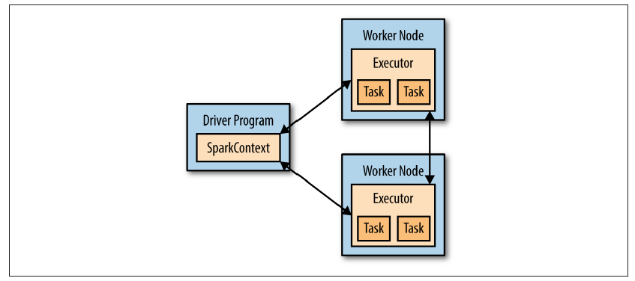
Components for Distributed execution in Spark

Slide 14
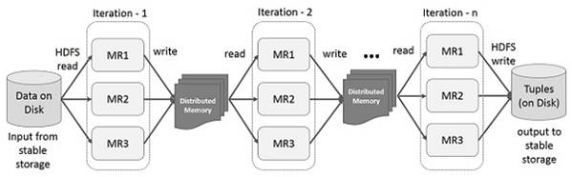
Interactive Processing using Spark
Spark framework is suitable for Interactive processing

Slide 15
Spark ideas
expressive computing system, not limited to map-reduce model
facilitate system memory
avoid saving intermediate results to disk
cache data for repetitive queries (e.g. for machine learning)
compatible with Hadoop

Slide 16
RDD abstraction
Resilient Distributed Datasets
partitioned collection of records
spread across the cluster
read-only
caching dataset in memory
different storage levels available
fallback to disk possible

Slide 17
RDD operations
transformations to build RDDs through deterministic operations on other RDDs
transformations include map, filter, join
lazy operation
actions to return value or export data
actions include count, collect, save
triggers execution

Slide 18

Job example
Driver
val log = sc.textFile(“hdfs://...”)
val errors = file.filter(_.contains(“ERROR”))
errors.cache()
errors.filter(_.contains(“I/O”)).count()
errors.filter(_.contains(“timeout”)).count()
Action!
Worker
Worker
Worker
Cache1
Cache2
Cache2
Block1
Block2
Block3

Slide 19
RDD partition-level view
Dataset-level view:
Partition-level view:
log:
HadoopRDD path = hdfs://...
errors:
FilteredRDD func = _.contains(…) shouldCache = true
Task 1
Task 2
...
source: https://cwiki.apache.org/confluence/display/SPARK/Spark+Internals

Slide 20
Job scheduling
RDD Objects
DAG Scheduler
Task Scheduler
Worker
Cluster manager
Threads
DAG
TaskSet
Task
Block manager
rdd1.join(rdd2) .groupBy(…)
.filter(…)
split graph into stages of tasks
launch tasks via cluster manager
execute tasks
submit each stage as ready
retry failed or straggling tasks
store and serve blocks
build operator DAG
source: https://cwiki.apache.org/confluence/display/SPARK/Spark+Internals

Slide 21
Available APIs
You can write in Java, Scala or Python
interactive interpreter: Scala & Python only
standalone applications: any
performance: Java & Scala are faster thanks to static typing

Slide 22
Hand on - interpreter
script
run scala spark interpreter
or python interpreter
http://cern.ch/kacper/spark.txt
$ spark-shell
$ pyspark

Slide 23
Commands walkthrough
val data = sc.textFile("data/geneva.csv") .map(_.split(";")) val tuples = data.filter(rec => (rec.length >= 9)) .mapPartitionsWithIndex{(idx, iter) => if (idx == 0) iter.drop(1) else iter} .map(rec => (rec(0), rec(8))) val dayonly = tuples .filter(rec => (rec._1.substring(12, 14).toInt > 7 && rec._1.substring(12, 14).toInt < 22)) val badweather = dayonly .filter(rec => rec._2 != "\"\"") val distdates = badweather .map(rec => rec._1.substring(1, 11)).distinct() val daysofweek = distdates .map(rec => DateTimeFormat.forPattern("dd.MM.yyyy") .parseLocalDateTime(rec).getDayOfWeek()) val counts = daysofweek.countByValue()

Slide 24
Hand on – build and submission
download and unpack source code
build definition in
source code
building
job submission
wget http://cern.ch/kacper/GvaWeather.tar.gz; tar -xzf GvaWeather.tar.gz
GvaWeather/gvaweather.sbt
GvaWeather/src/main/scala/GvaWeather.scala
cd GvaWeather
sbt package
spark-submit --master local --class GvaWeather \
target/scala-2.10/gva-weather_2.10-1.0.jar

Slide 25
Summary
concept not limited to single pass map-reduce
avoid soring intermediate results on disk or HDFS
speedup computations when reusing datasets

Slide 26
Programming with RDDs
An RDD is simply a distributed collection of elements. In Spark all work is expressed as either creating new RDDs, transforming existing RDDs, or calling operations on RDDs to compute a result.
Spark automatically distributes the data contained in RDDs across your cluster and parallelizes the operations you perform on them.

Slide 27
RDD
An RDD in Spark is simply an immutable distributed collection of objects.
Each RDD is split into multiple partitions, which may be computed on different nodes of the cluster.
RDDs can contain any type of Python, Java, or Scala objects, including userdefined classes.

Slide 28
Users create RDDs in two ways: by loading an external dataset, or by distributing a collection of objects (e.g., a list or set) in their driver program.
We have already seen loading a text file as an RDD of strings using SparkContext.textFile(). Creating an RDD of strings with textFile() in Python
lines = sc.textFile("README.md“)

Slide 29
Operations on RDDs
Transformations
Transformations construct a new RDD from a previous one.
Actions.
Actions compute a result based on an RDD, and either return it to the driver program or save it to an external storage system (e.g., HDFS).

Slide 30
Creating RDDs RDD.persist()
Spark provides two ways to create RDDs: loading an external dataset and parallelizing a collection in your driver program.
lines = sc.parallelize(["pandas", "i like pandas"])
lines = sc.textFile("/path/to/README.md")
If you would like to reuse an RDD in multiple actions, you can ask Spark to persist it using RDD.persist().

Slide 31
RDD Operations
Transformations are operations on RDDs that return a new RDD, such as map() and filter().
Actions are operations that return a result to the driver program or write it to storage, and kick off a computation, such as count() and first().

Slide 32
To select only error messages from logfile
In python
inputRDD = sc.textFile("log.txt")
errorsRDD = inputRDD.filter(lambda x: "error" in x)
In scala
val inputRDD = sc.textFile("log.txt")
val errorsRDD = inputRDD.filter(line => line.contains("error"))

Slide 33
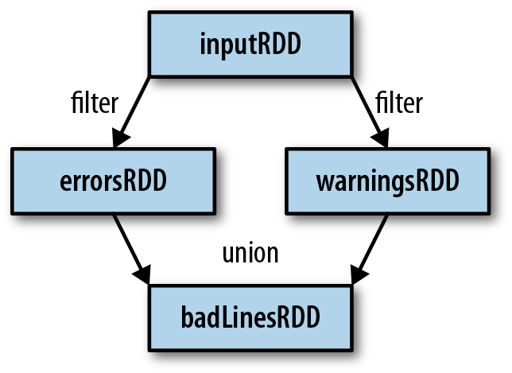
To print out the number of lines that contained either error or warning
errorsRDD = inputRDD.filter(lambda x: "error" in x)
warningsRDD = inputRDD.filter(lambda x: "warning" in x)
badLinesRDD = errorsRDD.union(warningsRDD)
union() is a bit different than filter(), in that it operates on two RDDs instead of one.

Slide 34
RDD actions
Actions force the evaluation of the transformations required for the RDD they were called on, since they need to actually produce output.
print "Input had " + badLinesRDD.count() + " concerning lines"
print "Here are 10 examples:"
for line in badLinesRDD.take(10):
print line

Slide 35
Lazy Evaluation
Transformations on RDDs are lazily evaluated, meaning that Spark will not begin to execute until it sees an action.
Lazy evaluation means that when we call a transformation on an RDD (for instance, calling map()), the operation is not immediately performed.
Instead, Spark internally records metadata to indicate that this operation has been requested. Rather than thinking of an RDD as containing specific data, it is best to think of each RDD as consisting of instructions on how to compute the data that we build up through transformations.
Loading data into an RDD is lazily evaluated in the same way transformations are.

Slide 36
To get squares of numbers
nums = sc.parallelize([1, 2, 3, 4])
squared = nums.map(lambda x: x * x).collect()
for num in squared:
print "%i " % (num)

Slide 37
Sometimes we want to produce multiple output elements for each input element. The operation to do this is called flatMap(). As with map(), the function we provide to flatMap() is called individually for each element in our input RDD.
Instead of returning a single element, we return an iterator with our return values.
Rather than producing an RDD of iterators, we get back an RDD that consists of the elements from all of the iterators.
lines = sc.parallelize(["hello world", "hi"])
words = lines.flatMap(lambda line

Slide 38
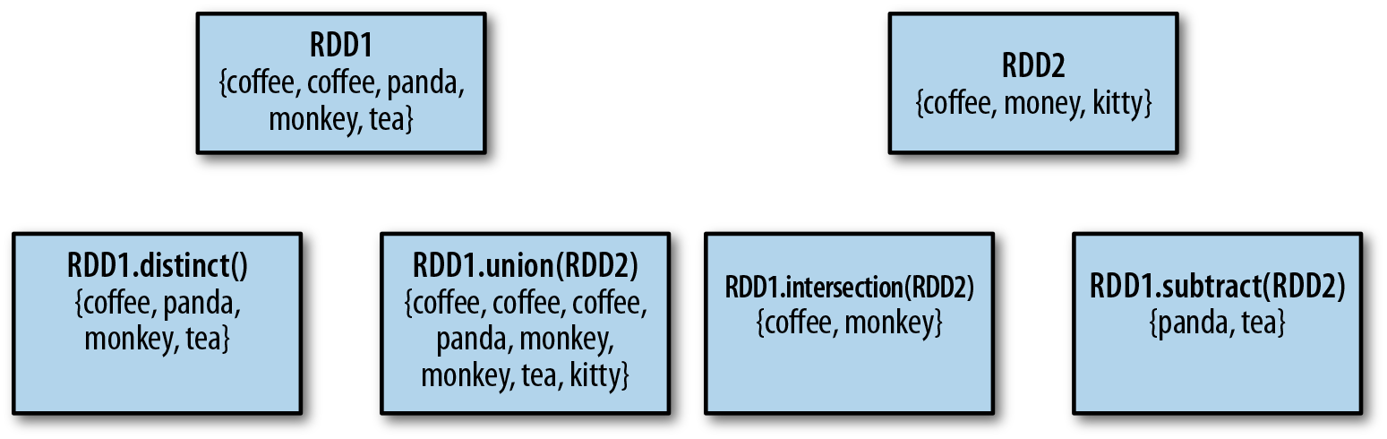
Set operations

Slide 39
collect() Return all elements from the RDD. rdd.collect() {1, 2, 3, 3}
count() Number of elements in the RDD.
rdd.count() 4
countByValue() Number of times each element
occurs in the RDD.
rdd.countByValue() {(1, 1),(2, 1),(3, 2)}

Slide 40
Creating Pair RDDs
Creating a pair RDD using the first word as the key in Python
pairs = lines.map(lambda x: (x.split(" ")[0], x))

Slide 41
Transformations on Pair RDDs
reduceByKey(func) | Combine values with the same key. | rdd.reduceByKey( (x, y) => x + y) | {(1,2), (3,10)}
groupByKey() | Group values with the same key. | rdd.groupByKey() | {(1,[2]),(3, [4,6])}
combineBy Key(createCombiner, mergeValue, mergeCombiners, partitioner) | Combine values with the same key using a different result type.
mapValues(func) | Apply a function to each value of a pair RDD without changing the key. | rdd.mapValues(x => x+1) | {(1,3), (3,5), (3, 7)}

Slide 42
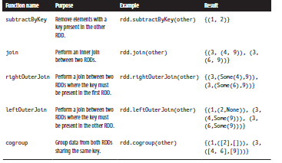
Transformation on pair RDDs

Slide 43
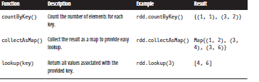
Actions on pair RDDs

